Slide 1

The Power of Quantum Neural Networks
Rajesh Sathya Kumar

Slide 2
Progress
While I am looking into various references for measuring quantum volume for quantum neural networks, Effective dimension is a very good measure in quantifying the effectiveness of the quantum models. On the next steps,
Presented the team on Quantum Performance Metrics
Moved Performance metrics and Effective Dimension from test python package index to http://www.pypi.org, along with samples for using the same.

Slide 3
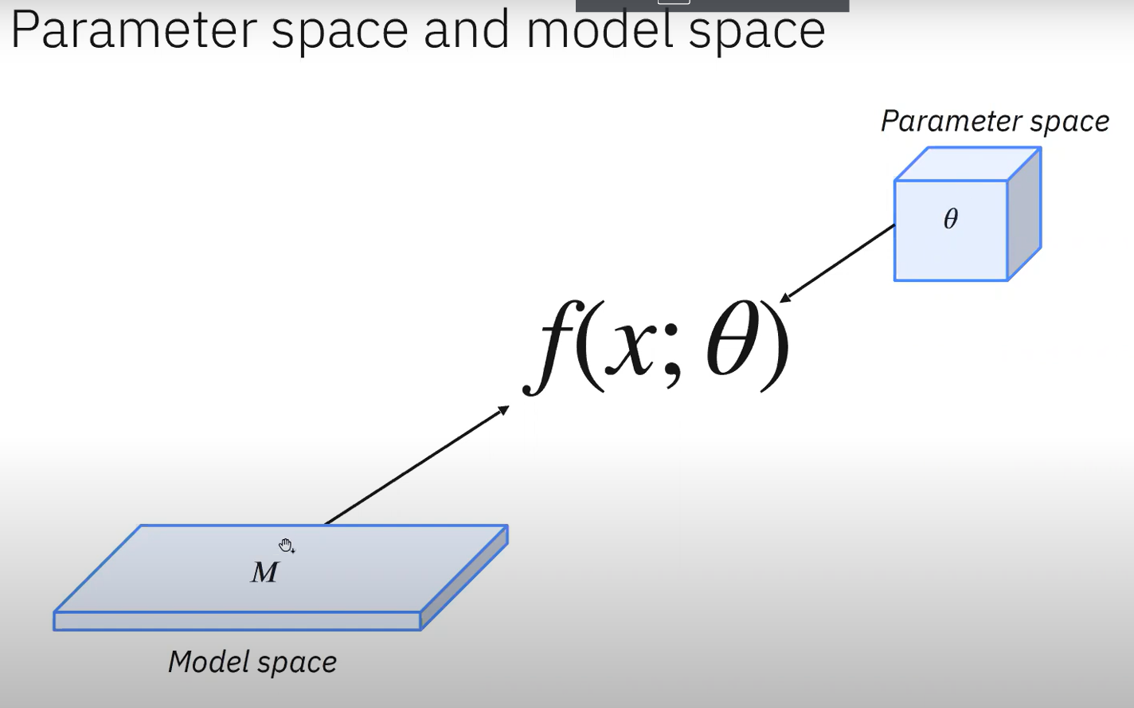
Parameter Space vs Model Space

Slide 4
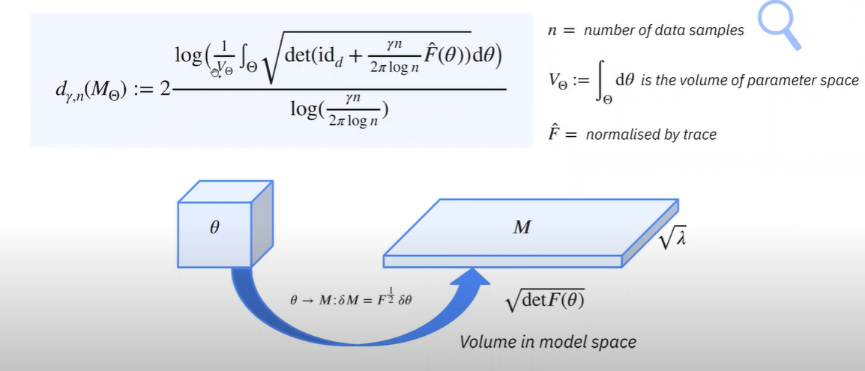
Effective Dimension
Effective dimension determines the effectiveness of our models. It gives us a sense of irrelevant features,
flat landscapes, etc.
Bereznuik et al. “A scale-dependent notion of effective dimension” arXiv preprint arXiv: 2001.10872 (2020)

Slide 5
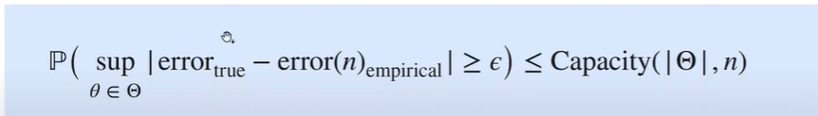
Effective Dimension and Generalization
Generalization Error
We want to make statements about the performance of a model on unseen data
A capacity measure can help give information about the generalization error by way of a generalization bound

Slide 6
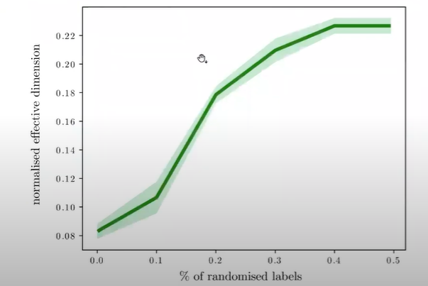
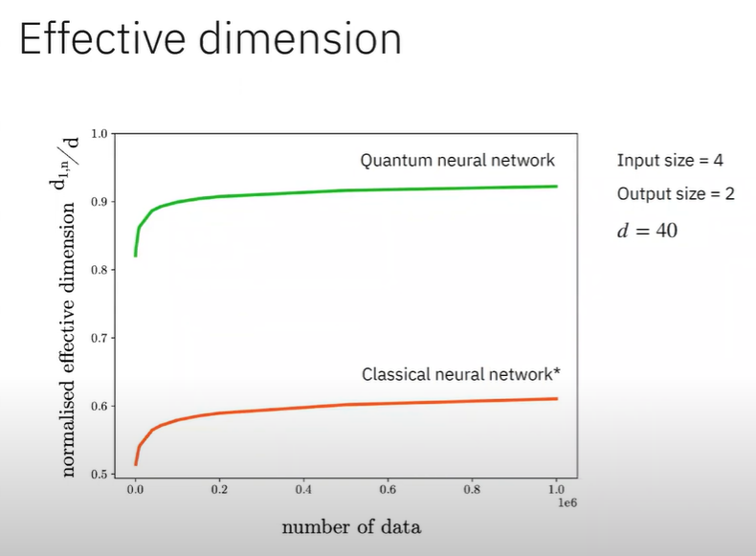
Generalization of Effective Dimension
Fig 1
Fig 2
Fig 1 and 2 cited from: Abbas, A., Sutter, D., Zoufal, C. et al. The power of quantum neural networks. Nat Comput Sci 1, 403–409 (2021). https://doi.org/10.1038/s43588-021-00084-1

Slide 7
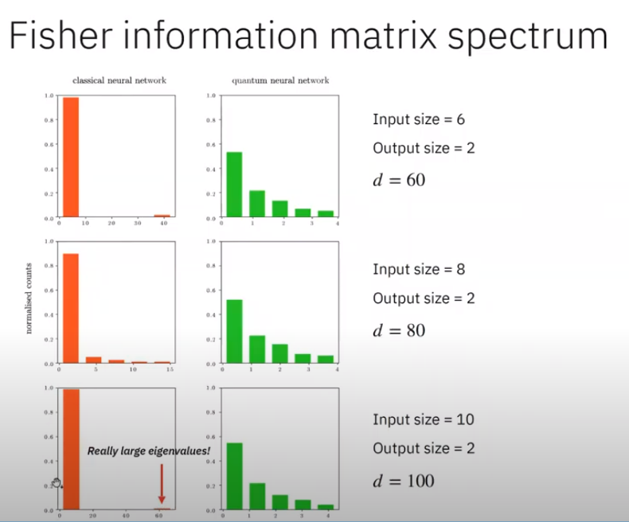
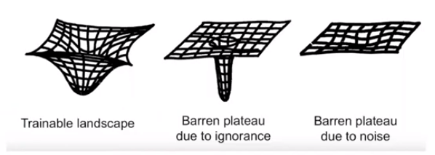
Fisher Information Matrix Spectrum
The Fisher information is a way of measuring the amount of information that an observable random variable X carries about an unknown parameter theta upon which the probability of X depends. (Source: Wikipedia)
Fig 3: Trainable Landscape [1]
Fig 4: Fisher Information Matrix Histogram

Slide 8
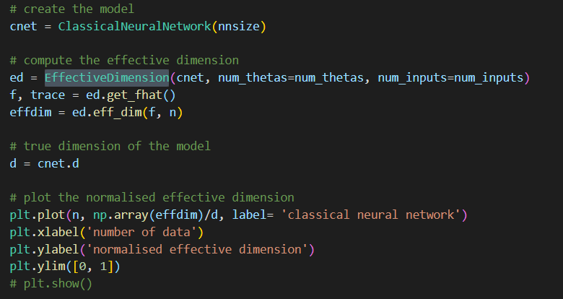
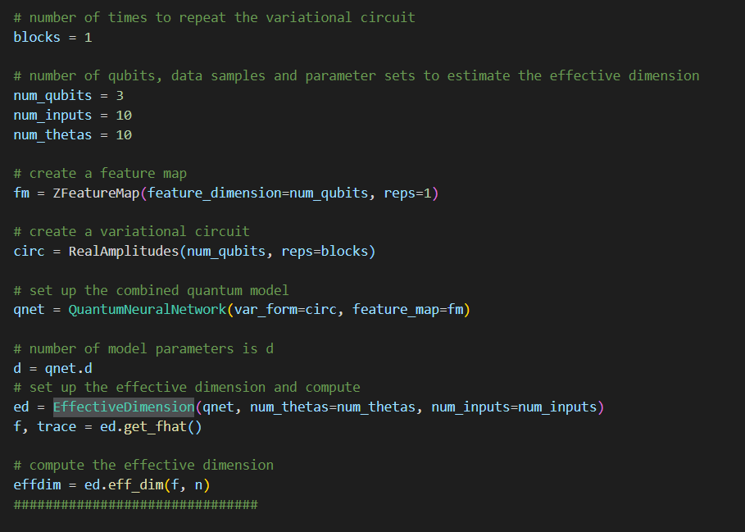
Example CNN and QNN
Modelling CNN
Modelling QNN

Slide 9
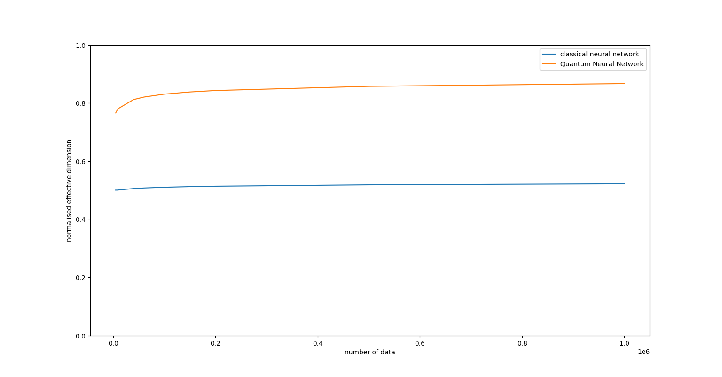
Effective Dimension Plot

Slide 10
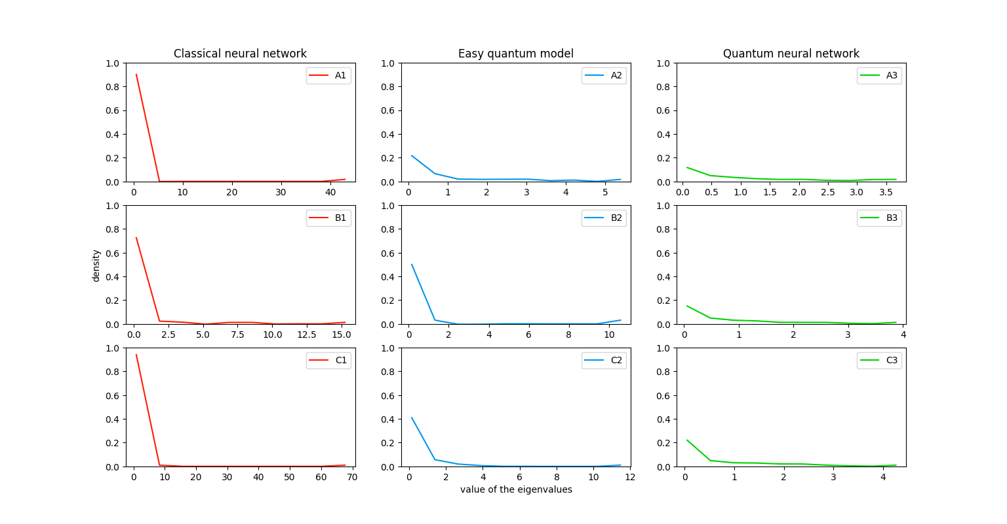
Eigen Value Histogram Plot

Slide 11
Reference
[1] Abbas, A., Sutter, D., Zoufal, C. et al. The power of quantum neural networks. Nat Comput Sci 1, 403–409 (2021). https://doi.org/10.1038/s43588-021-00084-1

Slide 12
Progress & Next Steps
This Week
Completed Implementation of Effective Dimension and pushed that to the library ‘qmetrics’
Working on updating my working document on error mitigation and the power of quantum neural networks
Worked on simulating QFT in JS
Next Steps
Completely focus on showcasing other metrics on Benchmarking Quantum neural networks

